Slide 1

UAV Planning, Autonomous Tracking, and Obstacle Identification and Avoidance
Álvaro Melgosa Pascual
1
Notes:
UAV=Unmanned Aerial Vehicle
OCAS for short

Slide 2

Motivation
Notes:
First of all, why am I doing this?
What is the purpose of this Thesis?

Slide 3
Motivation
Safety
Notes:
Most important issue in aerospace industry
UAVs can be considered part of aerospace industry, but not so safe
Disembarking the human eliminates intuitive sensing (inertial, visual, noise…)
Sensing has to be done by sensors and interpreted by computers for safe autonomous flight

Slide 4
Safety
Motivation
Improved
OCAS
Notes:
OCAS (similarly to TCAS in commercial aircraft) tries to eliminate the posibility of a physical collision of the UAV with its surroundings
OCAS operates as intermediate functional layer between operator and UAV

Slide 5
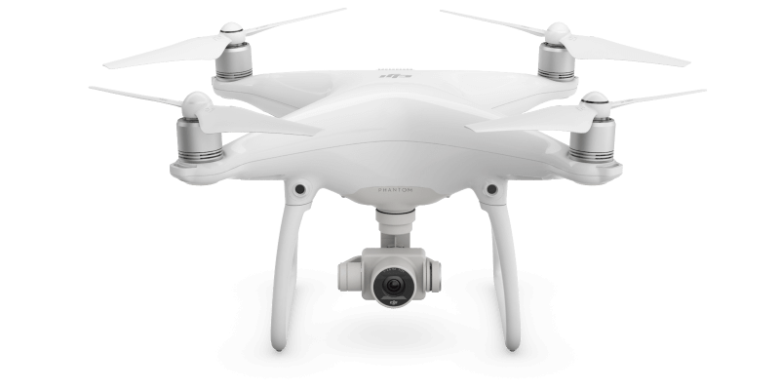
Example: DJI Phantom 4
Motivation
Source: dji.com
Notes:
Why is it important to have a reliable Obstacle Collision Avoidance System?
DJI recently (March 2016) built one into their Phantom 4
Based on stereoscopic cameras

Slide 6
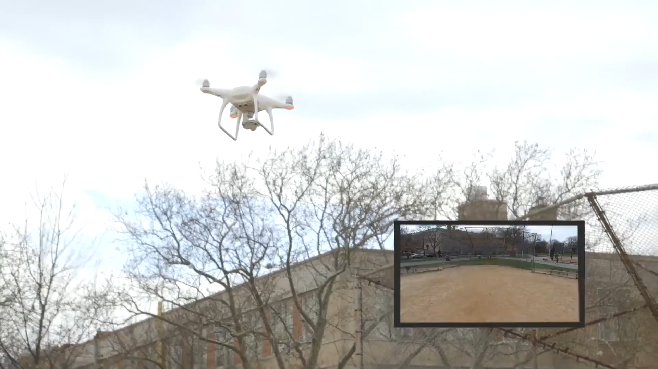
Regular operation
Motivation
Source: gizmodo.com
Notes:
Gizmodo journalists were testing the new features of the UAV
In particular the Emergency mode, that stops the vehicle when a collision is about to happen

Slide 7
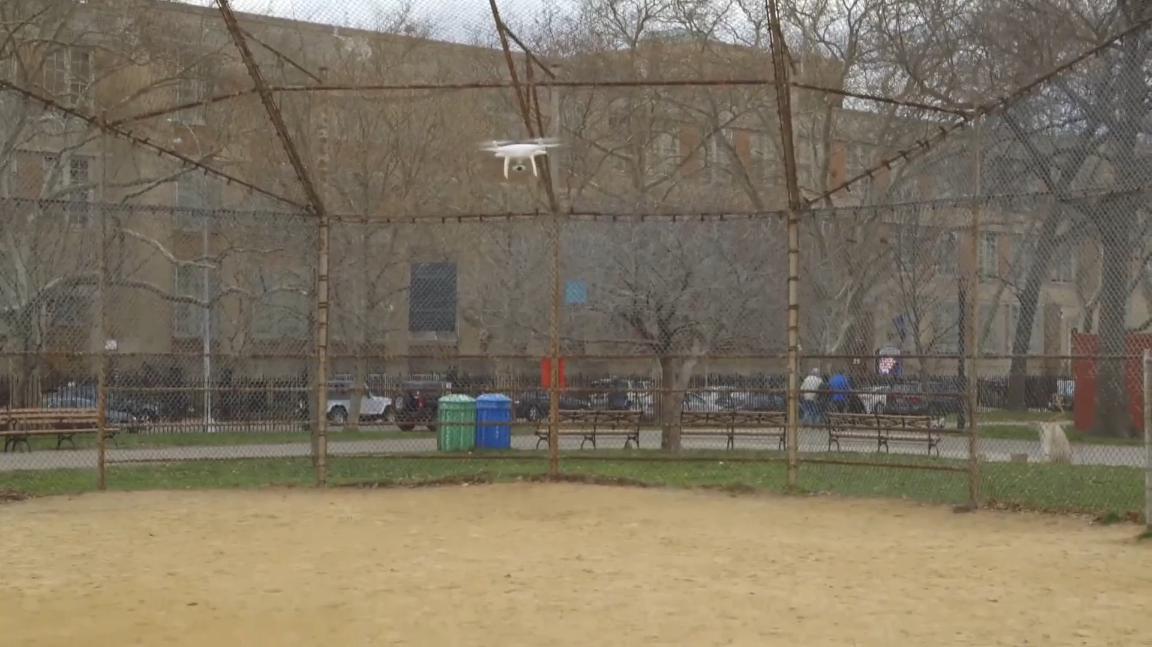
Faulty operation
Motivation
Source: gizmodo.com
Notes:
However, there are sometimes (Sport mode) that the Emergency mode is deactivated
The journalist was relying on that safety system while testing other features, and accidentally crashed the UAV

Slide 8
Motivation

